Slide 1
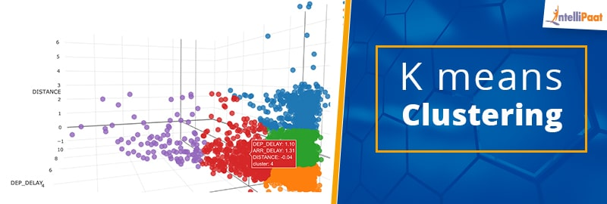
Fundamentals of machine learning
K-MEANS clustering
By
Gowtham chakri mallepaka(811240979)

Slide 2

Introduction
Data - Monthly fuel contract information, purchases, and costs
For this project only a part of the data is considered
Fuel_received_units “Quanity of fuel received in tons, barrel, or Mcf.”
Fuel_mmbtu_per_unit “Heat content of the fuel in millions of Btus per physical unit.”
Ash_content_pct

Slide 3
Problem statement
Fuel is a composition of many compounds like ash , sulfur, mercury etc
Are there any such compounds or combination of compounds that shows effect on full combustion?
Yes , one of such compound is ASH
What happens if the ash content is high in fuel?

Slide 4
Effects:
The results show that as ash content increases, the lower burning rate of fuel results in char particles leaving the grate without being fully burned, causing a loss of combustible material in the MSW. Therefore it reduces combustion efficiency
Higher amount of ash content reduces the calorific value of coal, causes health and environmental damages and lowers the boiler efficiency.
.
So , the data considered for this project is mentioned above

Slide 5
Techniques
The machine learning technique used for this is “K-means clustering”
Imputing the missing values by finding MEDIAN
Set seed
Data partition – training -75%
Normalization – Centre and scale
Silhouette method to identify the clusters

Slide 6
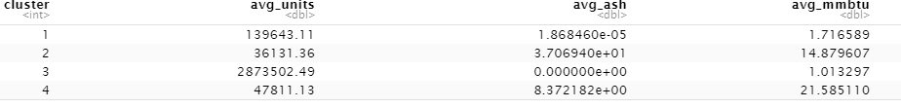
Clusters
Cluster 1 :- This can be said as the sub-optimal cluster
Cluster 2 :- Has lowest heat content
Clusters 3:- Has least or zero ash content and highest number of fuel units
Cluster 4 :- Has highest heat content an dash content

Slide 7
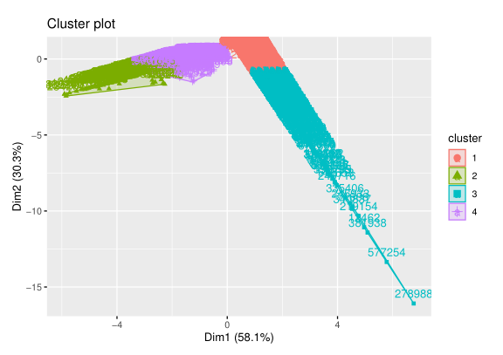
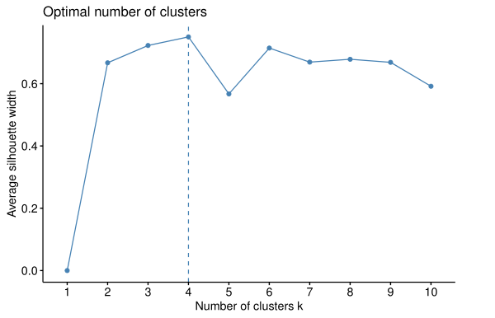
Data Analyis

Slide 8
Conclusions
If we were to name the clusters according to their characteristics it can be as follows
Cluster 1 – Suboptimal
Cluster 2 – Neutral
Cluster 3 – Environment friendly
Cluster 4 - Fuel efficient
The best cluster to choose from is cluster 3 (environment friendly). As there is no ash content and therefore it could become sustainable to use it.

